Slide 1
Creating and Using Report Parameters
Notes:
Schedule: Timing Topic
<xx> minutes Lecture
<xx> minutes Practice
<xx> minutes Total

Slide 2
Objectives
  After completing this lesson, you should be able to
do the following:
  Create and reference a parameter
  Create a list of values for parameter input
  Use and modify a system parameter
  Build a Paper Parameter Form layout
  Customize a Paper Parameter Form layout
  Use HTML parameter form extensions
Notes:
Lesson Aim
<Enter lesson aim here.>

Slide 3
User Parameters
  Restrict values in a WHERE clause
  Substitute any part of a SELECT statement
  Substitute a single column or expression
SELECT CUST_LAST_NAME, ACCOUNT_MGR_ID
FROM CUSTOMERS
WHERE ID =
<a value>
SELECT CUST_LAST_NAME, ACCOUNT_MGR_ID
FROM CUSTOMERS
<a where clause>
SELECT
FROM CUSTOMERS
<a column/expression>

Slide 4
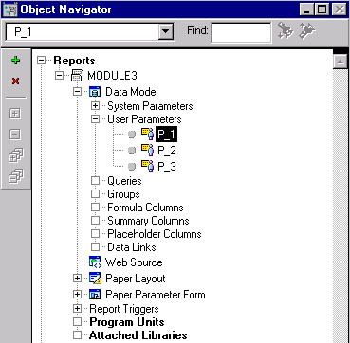
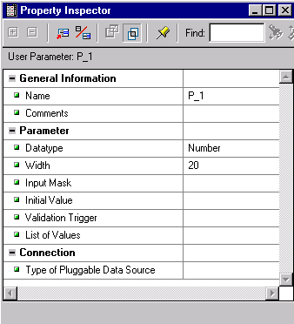
Creating a User Parameter

Slide 5
Referencing Parameters in a
Report Query
  Bind reference replaces a value:
    :parameter_name
    Parameter object can be created by default
  Lexical reference replaces a clause:
    &parameter_name
    Parameter object can be created by default

Slide 6
Using Bind References
  Restrict values in a WHERE clause
  Substitute a single value or expression in the select statement
SELECT CUST_LAST_NAME, ACCOUNT_MGR_ID
FROM CUSTOMERS
WHERE CUSTOMER_ID >
:P_CUST
SELECT CUST_LAST_NAME, ACCOUNT_MGR_ID
FROM CUSTOMERS
ORDER BY DECODE( , 1, CUST_LAST_NAME,
2, NLS_TERRITORY,
ACCOUNT_MGR_ID)
:SORT

Slide 7
Using Lexical References
  Use to substitute any part of the query.
  Make sure that the number and data types match at run time.
SELECT CUST_LAST_NAME, ACCOUNT_MGR_ID
FROM CUSTOMERS
SELECT CUST_LAST_NAME, ACCOUNT_MGR_ID
FROM CUSTOMERS
SELECT
FROM
&P_WHERE_CLAUSE
&P_ORD_CLAUSE
&P_WHERE_ORD_CLAUSE
&P_CUSTNAME CUST,
&P_ACCTMGR MGR
&P_TABLE

Slide 8
Hints and Tips When Referencing Parameters
  Always do the following:
  Specify column aliases when substituting column names
  Create lexical parameters explicitly in the Object Navigator
  Enter an initial value for parameters that affect query validation when NULL

Slide 9
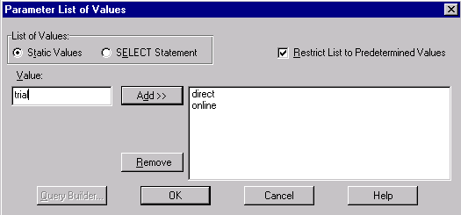
Static List of Values
1
2
3
4
5

Slide 10
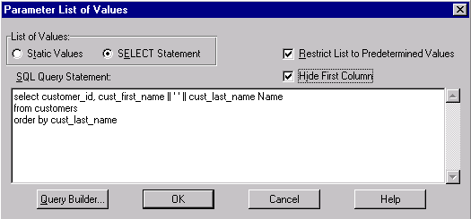
Dynamic List of Values
1
3
4
2
5

Slide 11
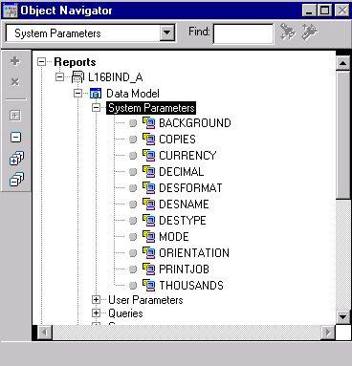
System Parameters

Slide 12
Displaying a Currency Symbol for Monetary Values
Build:
report:Parameter - CURRENCY
Initial Value
£
report:Layout Field - F_Money
£1000
£6000
£5000
Format Mask
$NNN0
€1000
€6000
€5000
Runtime:
RWRUN report=fred.rep...currency=€

Slide 13
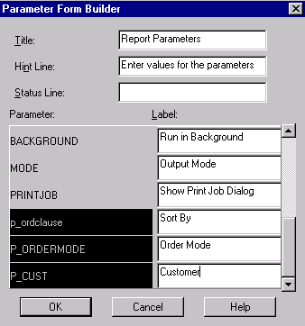
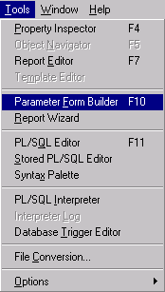
Building a Paper Parameter Form
+ Report properties:
Width
Height
Number of Pages

Slide 14
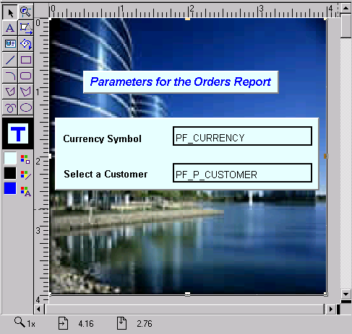
Customizing a Paper Parameter Form

Slide 15
Using Parameter Form HTML Extensions
  Boilerplate text with HTML tags
  Parameter fields with JavaScript
  Parameter Form header
  Parameter Form footer

Slide 16
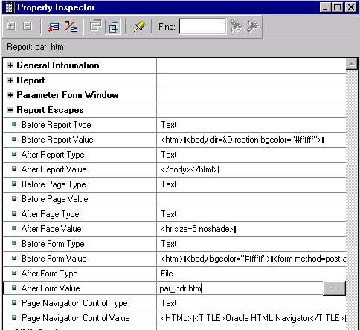
Parameter Form Header and Footer
Header
Footer

Slide 17
Summary
  In this lesson, you should have learned how to:
  Define and use bind and lexical parameters
  Create a list of values
  Reference system parameters
  Modify parameter values at run time, using:
    Command line arguments
    Run-time parameter form
  Create a run-time paper parameter form:
    Build it using the Parameter Form Builder
    Customize it using the Report Editor, HTML

Slide 18
Practice 16 Overview
  Modifying an existing report to use a bind parameter
  Adding a dynamic list of values
  Adding a lexical parameter
  Adding a static list of values
  Creating a customized parameter form

